Slide 2
FA to RE
Arden’s Rules
State Elimination method
Rule 1: The initial state of DFA must not have any incoming edge.
If there is any incoming edge to the initial edge, create a new initial state with no incoming edge
Rule 2: There must exist only one final state in DFA.
If there exist multiple final states, then convert all the final states into non-final states and create a new single final state.
Rule 3: The final state of DFA must not have any outgoing edge.
If this exists, then create a new final state having no outgoing edge from it.
Rule 4: Eliminate all intermediate states one by one.

Slide 3
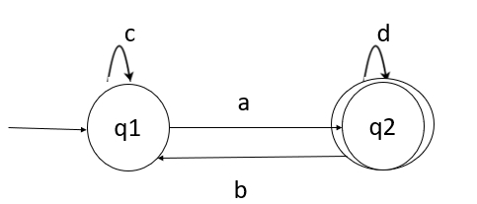
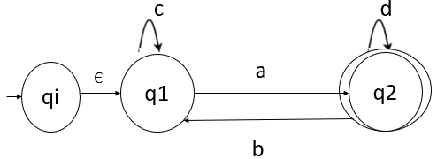
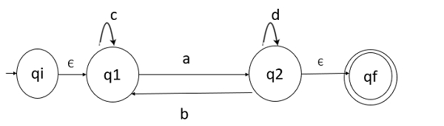
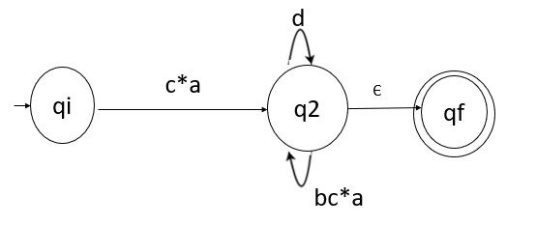
1) Create new initial state qi
2) Create new final state qf
Eliminate q1: εc* a from q1 to q2; q2 self loop b c*a
Eliminate q2: c*ad* from qi to qf; also c*abc*a from qi to qf
Answer: c*a (d* + bc*a)

Slide 4
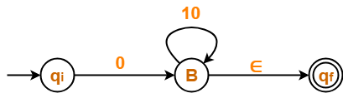
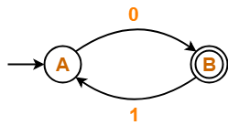
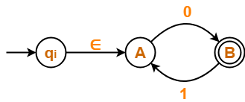

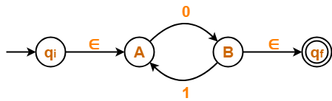

Slide 5
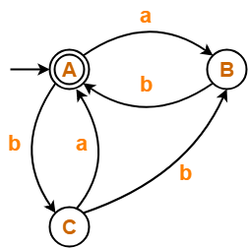
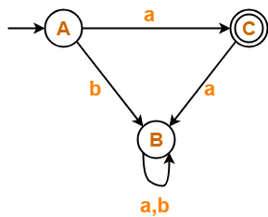
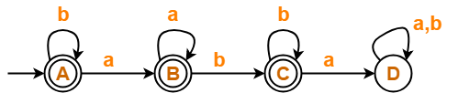
Example 1
Example 2
Example 3

Slide 6
Arden’s theorem
Let P and Q be two regular expressions.
If P does not contain null string, then R = Q + RP has a unique solution that is R = QP*
Assumptions for Applying Arden’s Theorem
The transition diagram must not have NULL transitions
It must have only one initial state
Method
Step 1 − Create equations for all the states of the DFA having n states with initial state q₁.
q₁ = q₁R₁₁ + q₂R₂₁ + … + q_{n}R_{n1} + ε
q₂ = q₁R₁₂ + q₂R₂₂ + … + q_{n}R_{n2}
…………………………
…………………………
q_{n} = q₁R_{1n} + q₂R_{2n} + … + q_{n}R_{nn}
R_{ij} represents the set of labels of edges from q_{i} to q_{j}, if no such edge exists, then R_{ij} = ∅
Step 2 − Solve these equations to get the equation for the final state in terms of R_{ij}

Slide 7
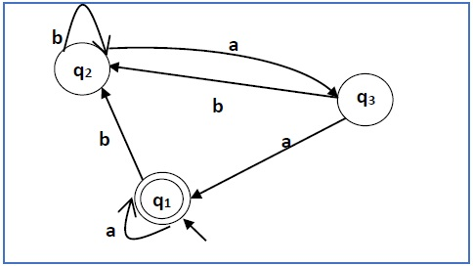
Example
The transition diagram must not have NULL transitions-Yes
It must have only one initial state - Yes
Equations:
q₁ = q₁a + q₃a + ε (ε move is because q1 is the initial state)
q₂ = q₁b + q₂b + q₃b
q₃ = q₂a
q₂ = q₁b + q₂b + q₃b
= q₁b + q₂b + (q₂a)b (Substituting value of q₃)
= q₁b + q₂(b + ab)
= q₁b (b + ab)* (Applying Arden’s Theorem)
q₁ = q₁a + q₃a + ε
= q₁a + q₂aa + ε (Substituting value of q₃)
= q₁a + q₁b(b + ab*)aa + ε (Substituting value of q₂)
= q₁(a + b(b + ab)*aa) + ε
= ε (a+ b(b + ab)*aa)*
= (a + b(b + ab)*aa)*
R = Q + RP R = QP*

Slide 8
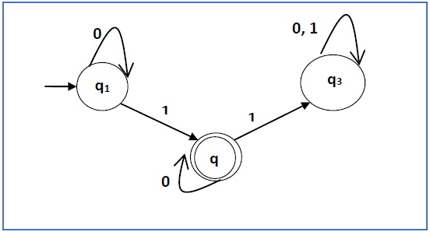
q₁ = q₁0 + ε
q₂ = q₁1 + q₂0
q₃ = q₂1 + q₃0 + q₃1
q₁ = ε0* [As, εR = R]
So, q₁ = 0*
q₂ = 0*1 + q₂0
So, q₂ = 0*1(0)* [By Arden’s theorem]

